Slide 1
Transformer Models
Advance NLP

Slide 2
Seq2seq model
Attention
Self Attention
Pre trained Transformer Model
Transformer

Slide 3
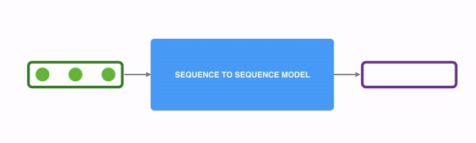
Sequence to Sequence model
Sequence to sequence models are deep learning models that have achieved a lot of success in tasks such as
Machine translation
Text generation
Image captioning
The input is represented in green, the model in blue and the output is purple.

Slide 4
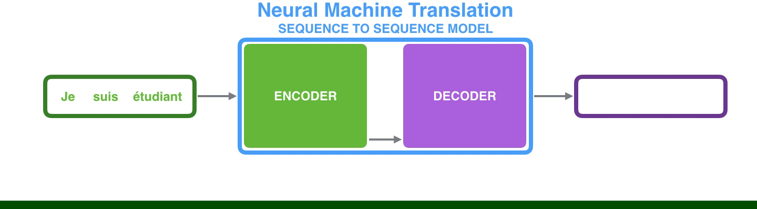
Inside sequence to sequence model
The sequence 2 sequence model internally consists of an encoder and decoder.
The encoder processes each item in the input sequence.
It compiles the information it captures into a vector (called the context) which is sent to decoder.
The decoder which begins producing the output sequence item by item.
Notes:
**Video

Slide 5

Recurrent Neural Networks(RNN)
Recurrent Neural Network architecture is used to handle these types of sequential data.
It can be thought of multiple copies of the same network.
RNN takes two inputs at each time step: an input (in the case of the encoder, one word from the input sentence), and a hidden state.

Slide 6
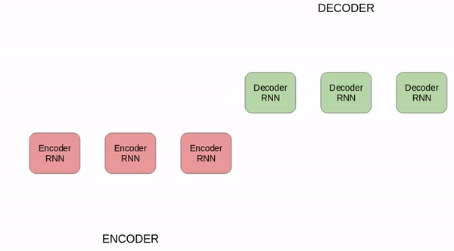

Slide 7
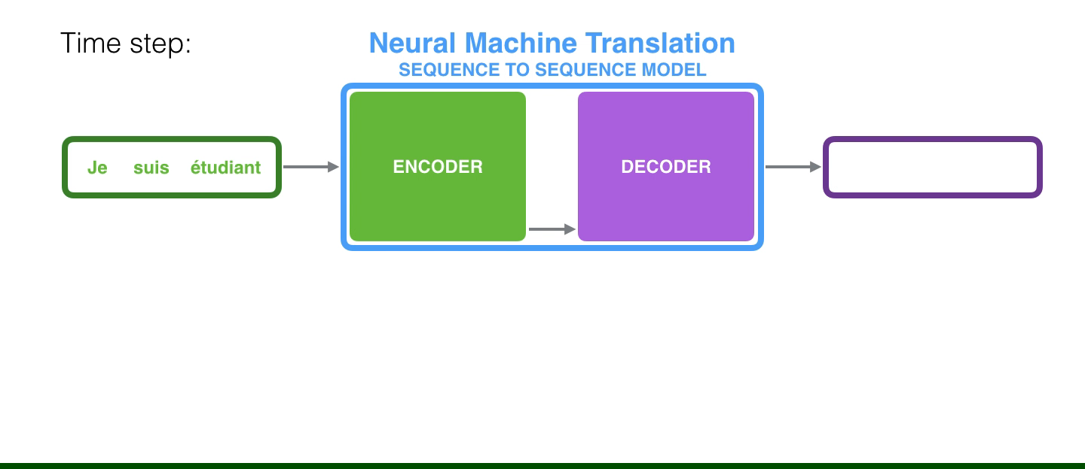
Problems with RNNs
The encoder only passes the hidden state for the last word as the context to the decoder.
This is an issue where RNNs become ineffective when the gap between the relevant information and the point where it is needed becomes too large.
Notes:
**Video

Slide 8
Seq2seq model
Attention
Self Attention
Pre trained Transformer Model
Transformer

Slide 9

What is Attention?
When you are listening to music, you pay special attention to some specific words.
Neural Network can achieve the same behavior using attention by focussing on a subset of information provided.

Slide 10
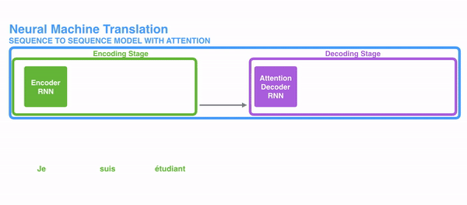
What happens in attention?
For RNNs instead of encoding the whole sentence in a hidden state, each word has a corresponding hidden state that is passed all the way to the decoding state.
The hidden states are used at each step for decoding.
In this way the encoder passes a lot of information to the decoder.

Slide 11
Idea behind attention
”The animal didn't cross the street because it was too tired”
Each word in the sentence might have relevant information.
In order for the decoding to be precise, it needs to take into account every word of the input using attention.

Slide 12
Attention Decoder
The attention decoder performs the following steps while decoding:
Looks at the set of encoder hidden states it has received. Each hidden state is associated with a specific word.
Provides a score for each hidden state.
Softmax the score
Multiply the softmax scores with the hidden state to drown out hidden state with low score and amplify hidden state with high score.
This will give us the context vector using which we can generate words.
Notes:
https://jalammar.github.io/visualizing-neural-machine-translation-mechanics-of-seq2seq-models-with-attention/

Slide 13
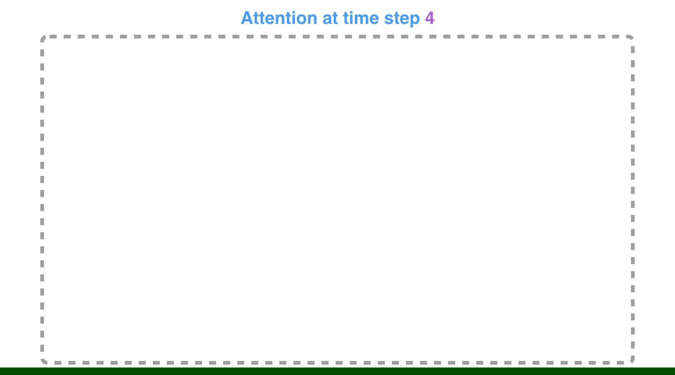
How Attention Decoder works?
Notes:
**Video

Slide 14
How Decoder generates words
The attention decoder RNN takes in the embedding of the <END> token, and an initial decoder hidden state.
The RNN processes its inputs, producing an output and a new hidden state vector (h4). The output is discarded.
Attention Step: We use the encoder hidden states and the h4 vector to calculate a context vector (C4) for this time step.(Discussed in the previous two slides)
We concatenate h4 and C4 into one vector.
We pass this vector through a feedforward neural network (one trained jointly with the model).
The output of the feedforward neural networks indicates the output word of this time step.
Repeat for the next time steps

Slide 15
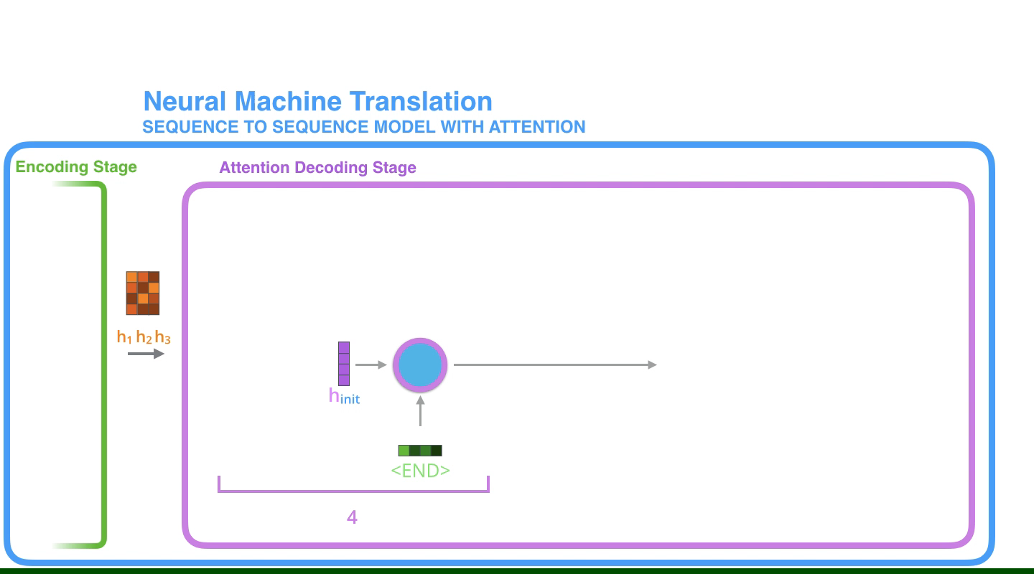
How Decoder generates words

Slide 16
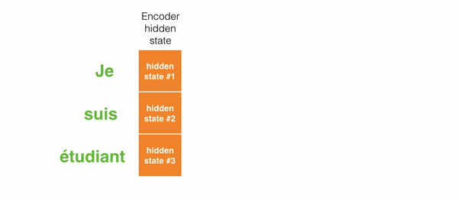
Final Output
The model is able to generate proper output irrespective of the position of input texts.
Remember, the model is not mindlessly mapping the first output word to the first input word.
It actually learns in the training phase how the words need to be aligned.

Slide 17
Seq2seq model
Attention
Self Attention
Pre trained Transformer Model
Transformer

Slide 18

Transformer
Transformer is a model that uses attention to boost the speed at which the models can be trained and perform.
Transformer was able to outperform Google Neural Machine Translation in specific tasks.
Let’s look at the language translation task to understand how they work.

Slide 19

High Level Overview
Internally all seq2seq models have an encoder and a decoder.

Slide 20

Let’s dig deeper
The encoder component has a stack of 6 encoder and it’s the same for decoder.
All the encoders are identical in structure and all the decoders are identical in structure.
Notes:
http://jalammar.github.io/illustrated-transformer/?source=post_page---------------------------

Slide 21
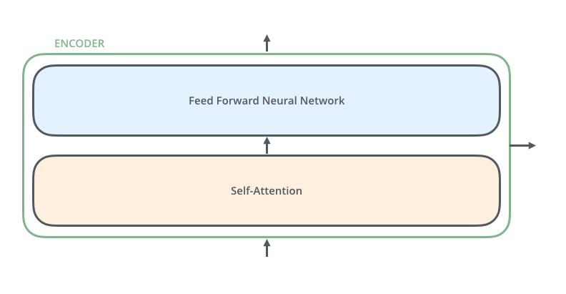
The encoder component
The encoder input first flows through self-attention layer which looks at other words in the input sentence as it encodes a specific word.
The output of the self attention is feed to a feed forward neural network

Slide 22
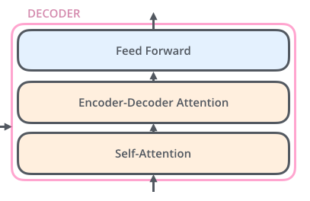
The decoder component
The decoder has the same layers except an encoder decoder attention layer that helps the decoder focus on the relevant parts of the input sentence.
Lets look at self attention in the next stage.

Slide 23
Seq2seq model
Attention
Self Attention
Pre trained Transformer Model
Transformer

Slide 24
Introducing Self Attention
”The animal didn't cross the street because it was too tired”
What does “it” in the above statement refers to? It is the street or the animal.
This is quiet easy for humans to understand, but not as simple to algorithms.
This is solved by using the concept of self attention.

Slide 25

What is Self Attention?
Self attention is the method that the Transformer uses to create understanding of other relevant words when we are currently processing one.

Slide 26
Self Attention in detail
We will calculate self attention with the following steps:
Create 3 vectors for each encoder’s input vector
Query vector
Key vector
Value vector
2. Calculating score of a word when comparing with other words in input. This is done by dot product of query vector of a word and key vector of other words.
3. Divide the scores by 8. This is square root of 64 which is the dimensions of key vector from the paper
4. Softmax the scores.
5. Multiply the Value vector with the softmax score. This will provide the relevant words and drown out the irrelevant words.
6. Sum up the weighted value vectors. This produces the output of self attention layer at the current position.

Slide 27

Self Attention in detail
This will produce the output of self attention which helps to understand how each words is related to other words in the input sentence.

Slide 28
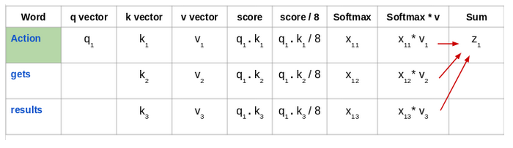
Self Attention in detail
This is how we calculate self attention for the word “Action” in the sequence “Action gets results”.
We will repeat the same steps for all the words and get their self attention values.

Slide 29
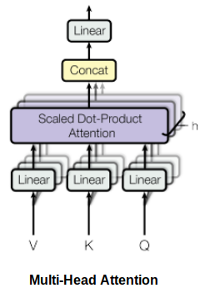
Multi Headed Attention
Self Attention is calculated multiple times in the Transformer’s architecture in parallel and independently.
It is therefore referred to as Multi Headed Attention.
The output is concatenated and linearly transformed from various self attentions.

Slide 30
Seq2seq model
Attention
Self Attention
Pre trained Transformer Models
Transformer

Slide 31
Pre trained Transformer Model
Transformer based models are the secret behind the state of the art breakthroughs in NLP.
It has outperformed Google’s Neural Machine Translation in various tasks.
Some of the popular pre-trained Transformer Models are:
BERT
GPT-2
XLNet

